Slide 1
LECTURE # 6
RELATIONS

Slide 2
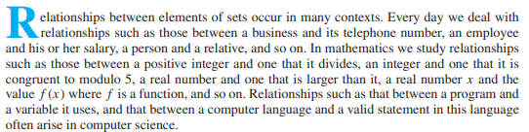

Relations & their Properties

Slide 3

Relations
Relationships between elements of sets are represented using the structure called a relation, which is just a subset of the Cartesian product of the sets.
It can be used to solve problems such as determining which pairs of cities are linked by airline ﬂights in a network.
ORDERED PAIRED
The most direct way to express a relationship between elements of two sets is to use ordered pairs made up of two related elements. For this reason, sets of ordered pairs are called binary relations.

Slide 4
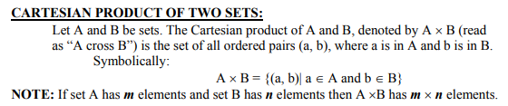
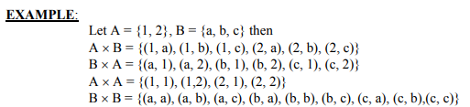

Slide 5
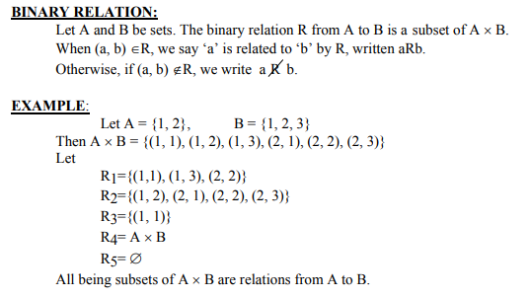
Subset of Cartesian product

Slide 6
Solution
Let A = {0, 1, 2} and B = {a, b}.
Then
{(0, a), (0, b), (1, a), (2, b)} is a relation from A to B. This means, for instance, that
x R y, but that not 1 R b. Relations can be represented graphically.
0 •
R a b
a
0
1
2
x x
x
x
1 •
b
2 •

Slide 7

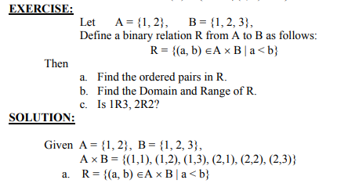


Slide 8
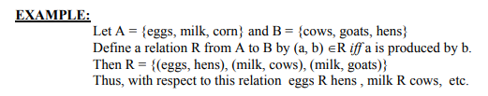
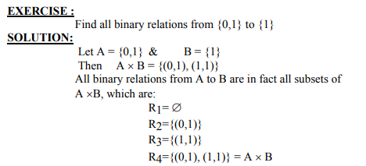

Slide 9
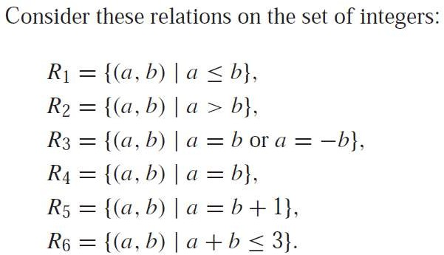
Example
Which of these relations contain each of the pairs (1, 1), (1, 2),
(2, 1), (1,−1), and (2, 2)?

Slide 10
Example
Which of these relations contain each of the pairs (1, 1), (1, 2),
(2, 1), (1,−1), and (2, 2)?
The pair
(1, 1) is in R₁, R₃, R₄, and R₆;
(1, 2) is in R₁ and R₆;
(2, 1) is in R₂, R₅, and R₆;
(1,−1) is in R₂, R₃, and R₆; and,
(2, 2) is in R₁, R₃, and R₄.

Slide 11
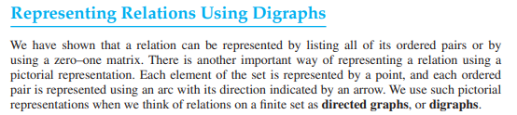
Representing Relations using Digraphs
Definition 1
A directed graph, or digraph, consists of a set V of vertices (or nodes) together with a set E of ordered pairs of elements of V called edges (or arcs). The vertex a is called the initial vertex of the edge (a, b), and the vertex b is called the terminal vertex of this edge.
An edge of the form (a, a) is represented using an arc from the vertex a
back to itself. Such an edge is called a loop.

Slide 12
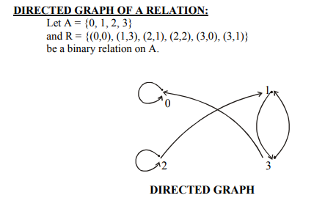
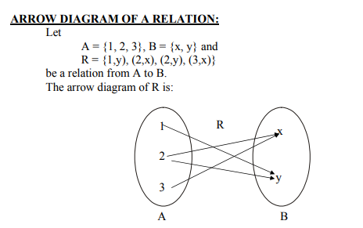

Slide 13
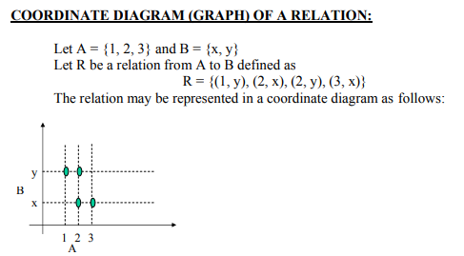

Slide 14
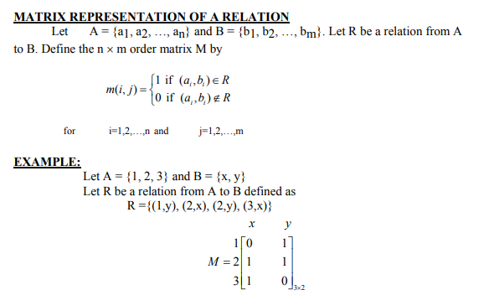

Slide 15
Union of Matrices
The matrix representing the union of two or more relations has a 1 in the positions where either M_{R1} or M_{R2} has a 1.
^{M}R₁ U R₂
= M_{R1} V M_{R2}
Intersection of Matrices
The matrix representing the intersection of two or more relations has a 1 in the positions where both M_{R1} and M_{R2} have a 1.
^{M}R₁ ∩ R₂
= M_{R1} ꓥ M_{R2}

Slide 16
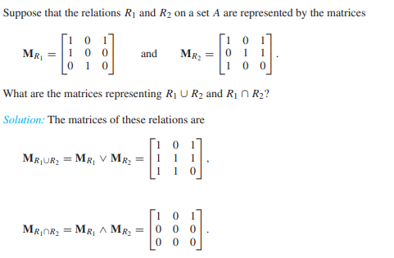

Slide 17
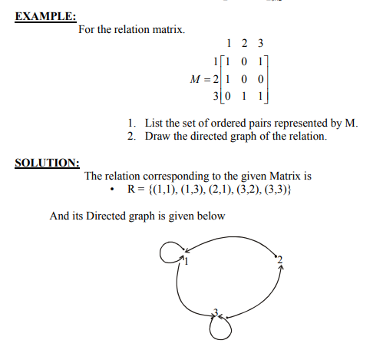

Slide 18
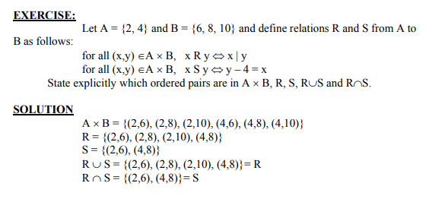

Slide 19


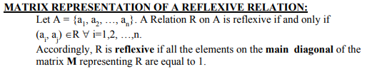

Slide 20
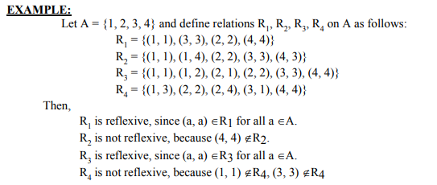
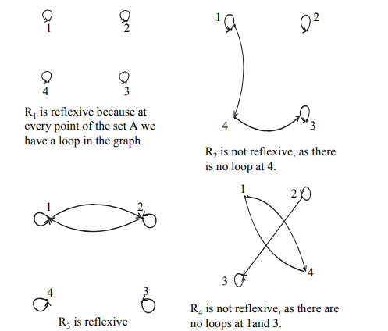

Slide 21
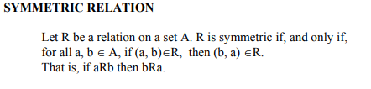
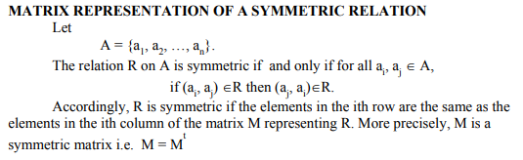
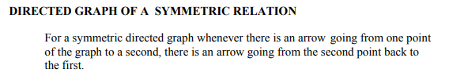

Slide 22
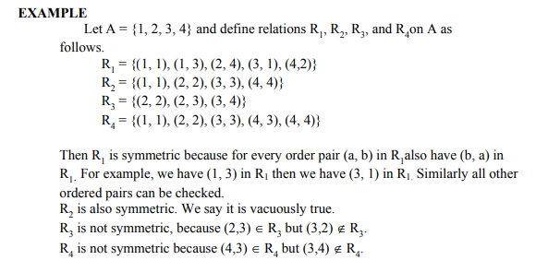
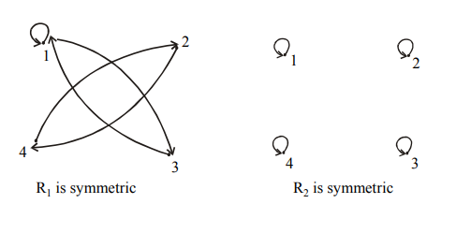
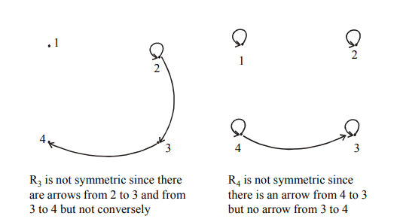

Slide 23
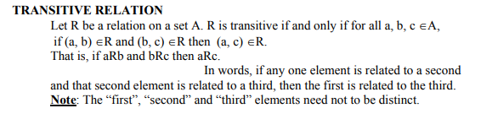

Slide 24
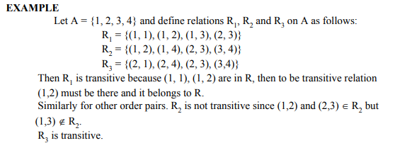
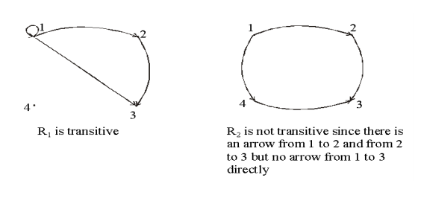
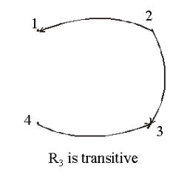

Slide 25



Slide 26


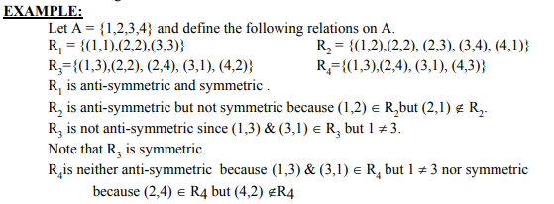

Slide 27
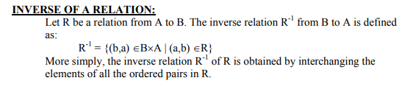
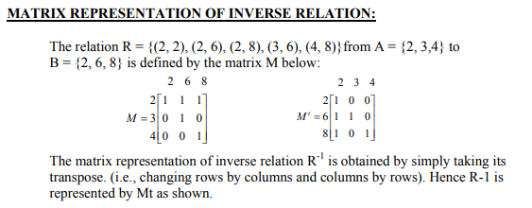

Slide 28


Slide 29
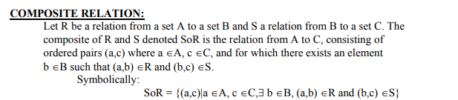

Slide 30
